Slide 1
I/O MANAGEMENT
CS 3100 – Chapter 13
SUPPLEMENTAL NOTES

Slide 2
Categories of I/O Devices
Human readable
  Printers, Monitors, Keyboard, Mouse
Machine readable
  Disk and tape drives, Sensors, Controllers, and Actuators
Communication
  Digital line drivers, Modems

Slide 3
I/O Hardware
Common concepts:
  Port – connection point to the computer
  Bus (daisy chain or shared direct access)
  Controller (host adapter)
I/O instructions control devices
Devices have addresses, used by:
  Direct I/O instructions
  Memory-mapped I/O

Slide 4
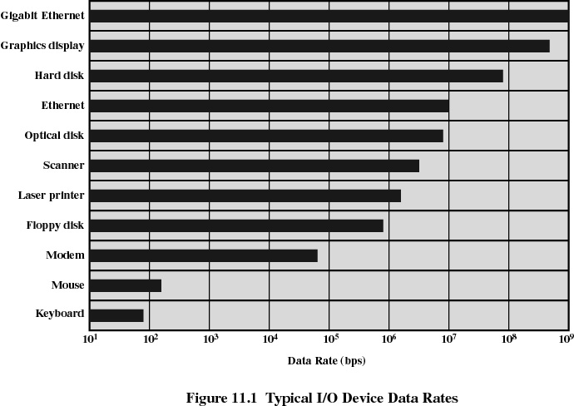
Differences in I/O Devices
Data rate
  May be differences of several orders of magnitude between the data transfer rates

Slide 5
Differences in I/O Devices
Application
  Disk used to store files requires file-management software (Chapters 10-11)
  Disk used to store virtual memory pages needs special hardware (MMU) and software to support it (Chapter 9)
  Terminal used by system administrator may have a higher priority than one utilized by an ordinary user.

Slide 6
Differences in I/O Devices
Complexity of control
  Keyboard vs. Disk Drive
Unit of transfer
  Data may be transferred as a stream of bytes for a terminal or in larger blocks for a disk
Data representation
  Encoding schemes (encrypted, etc)
Error handling
  Devices respond to errors differently

Slide 7
Techniques for Performing I/O
Programmed I/O (Polling)
  Process is “busy-waiting” for the operation to complete
Interrupt-driven I/O
  I/O command is issued
  Processor continues executing instructions
  I/O module sends an interrupt when done

Slide 8
Polling
Determines state of device
  command-ready
  busy
  error
The “busy-wait” cycle is used to wait for I/O from the device
  Controller indicates its state through a busy bit in the state register.
  Host repeatedly reads the busy bit until it becomes clear.

Slide 9
Techniques for Performing I/O
2. Interrupt-driven I/O
  I/O command is issued
  Processor continues executing instructions
  I/O module sends an interrupt when done

Slide 10
Interrupts
CPU interrupt request line is triggered by the I/O device (use an IRQ #)
Interrupt handler services the interrupt
Maskable to ignore or delay some interrupts
Interrupt vector contains the address of the correct handler
  Based on priority
Interrupt mechanism can also be used for exceptions (div by zero, protected / kernel memory access).

Slide 11
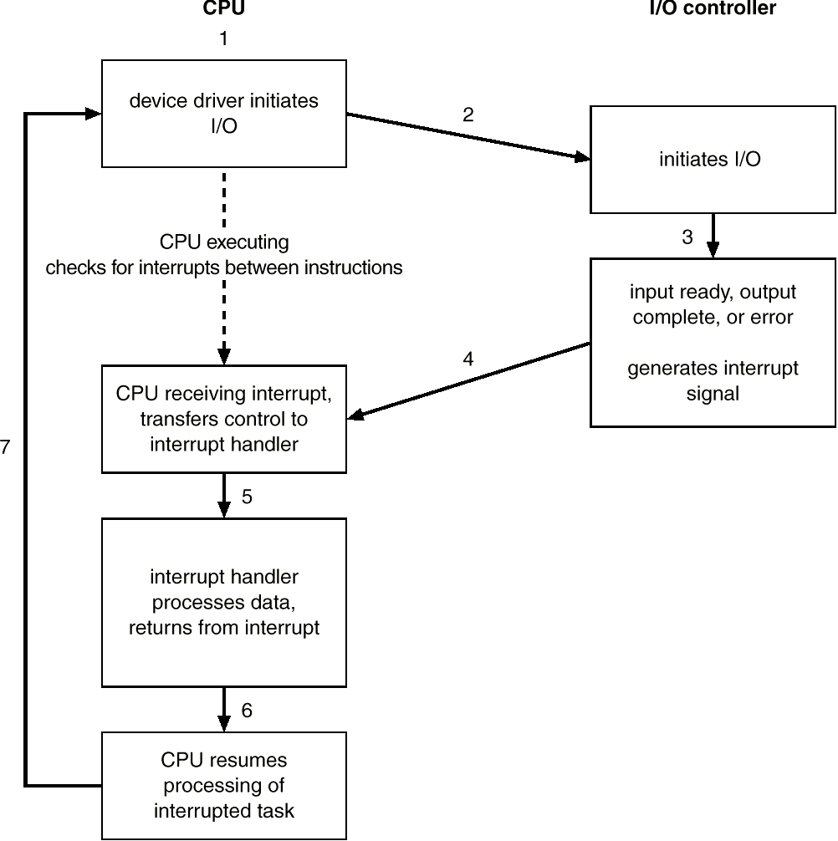
Interrupt Driven I/O Cycle

Slide 12
Techniques for Performing I/O
Direct Memory Access (DMA)
  DMA module controls exchange of data between main memory and the I/O device
  Processor sends a request for the transfer of a block of data to the DMA module.
  Processor interrupted only after entire block has been transferred

Slide 13
Direct Memory Access
Used to avoid programmed I/O for large data transfers
Requires DMA controller
Bypasses CPU to transfer data directly between I/O device and memory
DMA Command Block
  Source and Destination Pointers
  Block Count

Slide 14
Direct Memory Access
DMA Module mimics the processor and takes control of the system from the CPU to transfer data to and from memory over the system bus
“Cycle stealing” is used to transfer data on the system bus
The CPU pauses one bus cycle and the instruction cycle is suspended so data can be transferred
No interrupts occur in the Processor
  Processes do not save context

Slide 15
DMA
DMA “Cycle stealing” causes the CPU to execute more slowly
However, the number of required busy cycles can be cut by integrating the DMA and I/O functions and finding a path between DMA module and I/O module that does not include the system bus (basically, as separate I/O Bus).

Slide 16
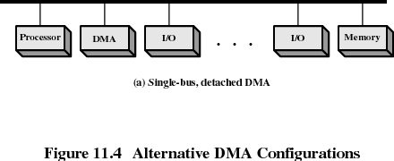
DMA

Slide 17
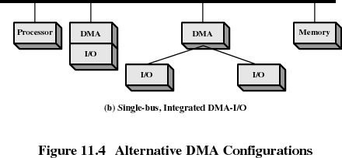
DMA

Slide 18
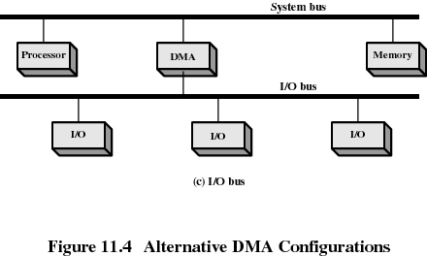
DMA

Slide 19

Six step process to perform DMA transfer

Slide 20
I/O Buffering
Buffering - store data in memory while transferring between devices / applications
  To cope with device speed mismatch
  To cope with device transfer size mismatch
  To maintain “copy semantics”
Reasons for buffering
  Processes must wait for I/O to complete before proceeding
  Certain pages must remain in main memory during I/O

Slide 21
I/O Buffering
Block-oriented devices
  Information is stored in fixed sized blocks
  Transfers are made a block at a time
  Used for disks and tapes
Stream-oriented devices
  Transfer information as a stream of bytes
  Used for terminals, printers, communication ports, mouse, and most other devices that are not secondary storage

Slide 22
Single Buffer
Operating system assigns a buffer in main memory for an I/O request
Block-oriented
  Input transfers made to a buffer
  Block moved to user space when needed
  User process can process one block of data while next block is read in
    Read ahead
  Swapping can occur since input is taking place in system memory, not user memory

Slide 23
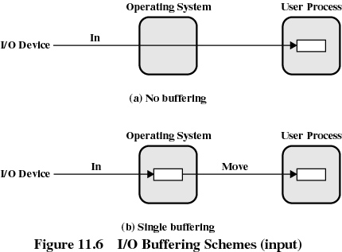
Single Buffer
Stream-oriented
  Used for a line at time
  User input from a terminal is one line at a time with carriage return signaling the end of the line
  Output to the terminal is one line at a time

Slide 24
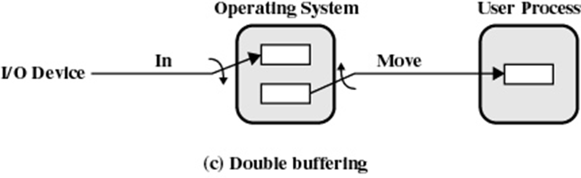
Double Buffer
Uses two system buffers instead of one
A new process can transfer data to or from one buffer while the operating system empties or fills the other buffer

Slide 25
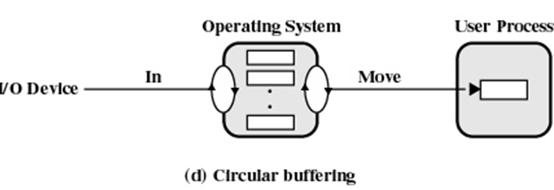
Circular Buffer
More than two buffers are used
Each individual buffer is one device in a circular buffer
Used when I/O operation must keep up with process (rapid bursts)

Slide 26
Other ways to mange I/O
Caching - fast memory holding copy of data
  Always just a copy – not like buffer
  Key to fast I/O performance
Spooling - hold output for a device
  If device can serve only one request at a time
  Printing is an example

Slide 27
Performance
I/O a major factor in system performance
  It places heavy demands on the CPU to execute device driver, kernel I/O code
  Context switches occur, due to interrupts
  Data copying between Virtual and Physical Memory
  Network traffic especially stressful

Slide 28
Improving Performance
Reduce number of context switches
Reduce data copying
Reduce interrupts by using large transfers, smart controllers, polling
Use DMA
Balance CPU, memory, bus, and I/O performance for highest throughput

